Slide 1
Chapter 4 : Intermediate SQL

Slide 2
Outline
Join Expressions
Views
Transactions
Integrity Constraints
SQL Data Types and Schemas
Index Definition in SQL
Authorization
Notes:
1

Slide 3
Joined Relations
Join operations take two relations and return as a result another relation.
A join operation is a Cartesian product which requires that tuples in the two relations match (under some condition). It also specifies the attributes that are present in the result of the join
The join operations are typically used as subquery expressions in the from clause
Three types of joins:
Natural join
Inner join
Outer join

Slide 4
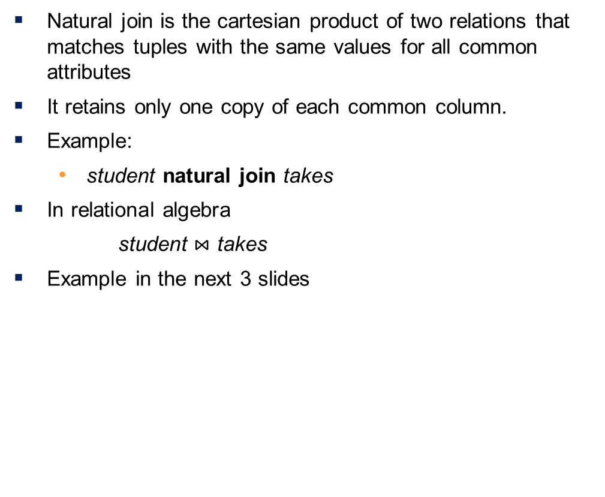
Natural Join in SQL
Natural join is the cartesian product of two relations that matches tuples with the same values for all common attributes
It retains only one copy of each common column.
Example:
student natural join takes
In relational algebra
$\text{student}⋈$ takes
Example in the next 3 slides

Slide 5
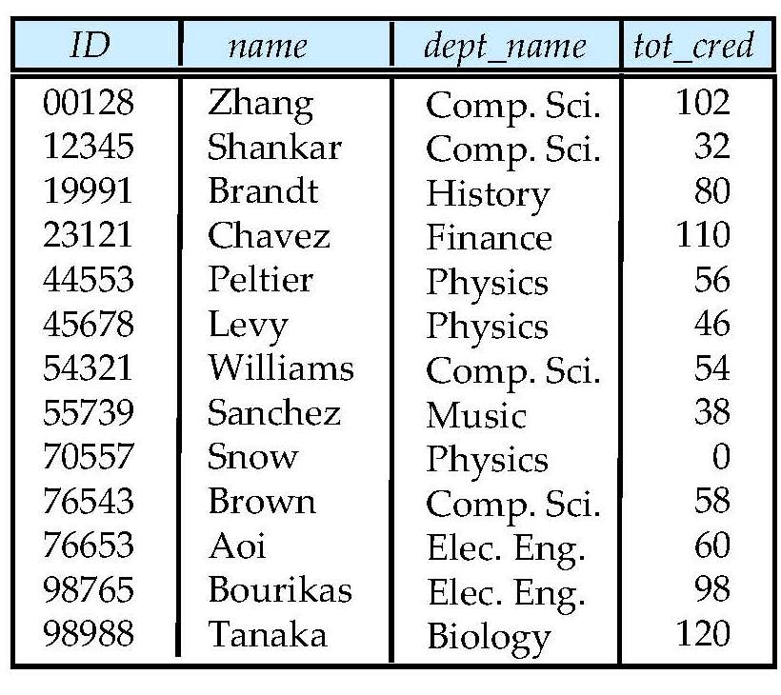
Student Relation

Slide 6
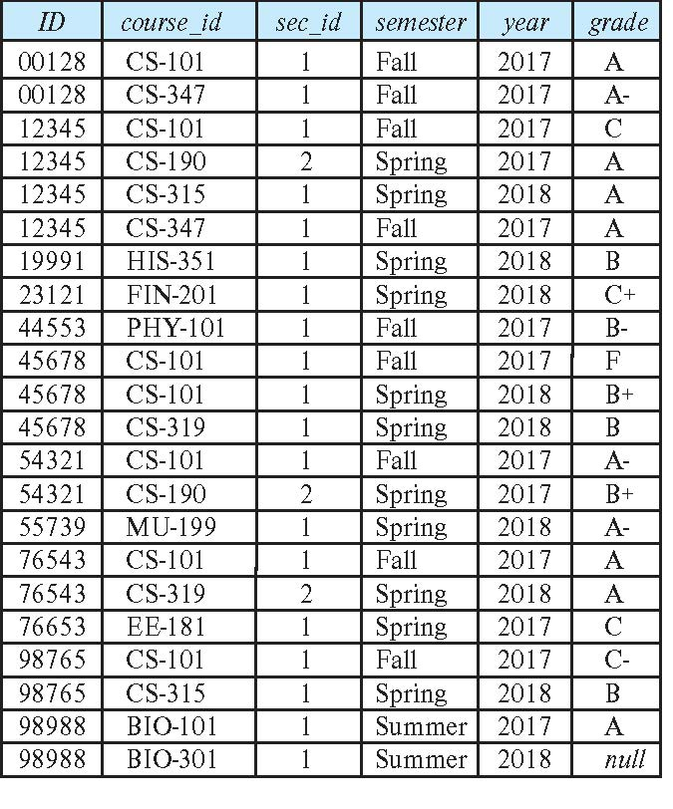
Takes Relation

Slide 7
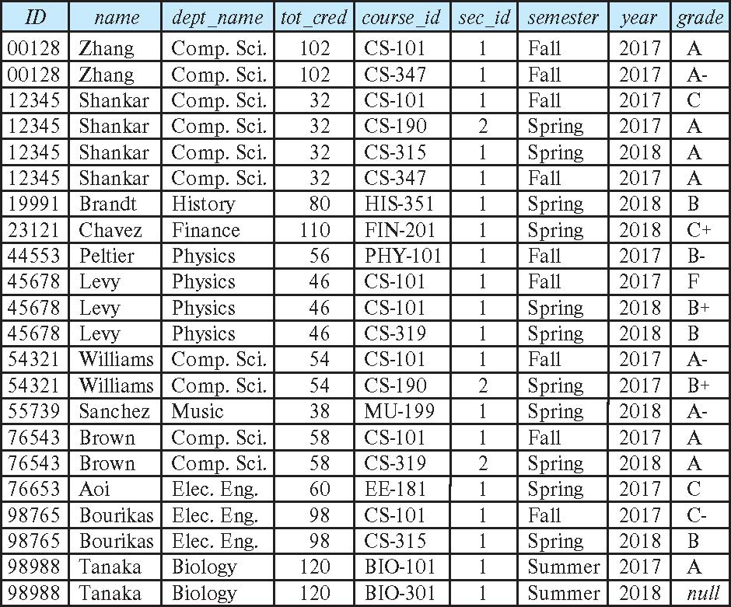
student natural join takes

Slide 8
Natural Join Use Example
List the names of instructors along with the course ID of the courses that they taught
select name, course_id from instructor natural join takes
The same query without the use of natural join
select name, course_id from instructor , takes where instructor.ID = takes.ID

Slide 9
Natural Join Structure in SQL
The from clause can have multiple relations combined using natural join:
select A₁, A₂, … A_{n} from r₁ natural join r₂ natural join .. natural join r_{n} where P ;

Slide 10
Dangerous in Natural Join
Beware of unrelated attributes with same name which get equated incorrectly
Example -- List the names of students along with the titles of courses that they have taken
Correct version
select name, title from student natural join takes, course where takes.course_id = course.course_id;
Incorrect version
select name, title from student natural join takes natural join course;
This query omits all (student name, course title) pairs where the student takes a course in a department other than the student's own department.
The correct version (above), correctly outputs such pairs.

Slide 11
Natural Join with Using Clause
To avoid the danger of equating attributes erroneously, we can use the “using” construct that allows us to specify exactly which columns should be equated.
Query example
select name, title from (student natural join takes) join course using (course_id)

Slide 12
Join Condition
The on condition allows a general predicate over the relations being joined
This predicate is written like a where clause predicate except for the use of the keyword on
Query example:
Query
select * from student join takes on student_ID = takes_ID
The on condition above specifies that a tuple from student matches a tuple from takes if their ID values are equal.
Equivalent to:
select * from student , takes where student_ID = takes_ID

Slide 13
Outer Join
An extension of the join operation that avoids loss of information.
Computes the join and then adds tuples form one relation that does not match tuples in the other relation to the result of the join.
Uses null values.
Three forms of outer join:
left outer join
right outer join
full outer join

Slide 14
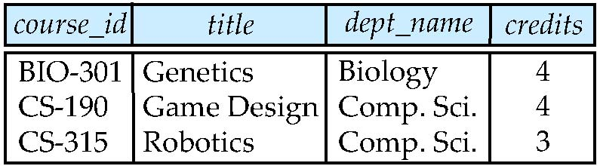
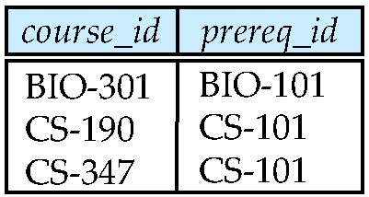
Outer Join Example Tables
course relation
prereq relation
Observe that
course information is missing CS-347
prereq information is missing CS-315

Slide 15
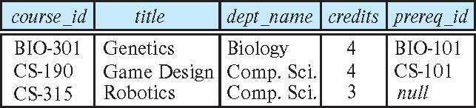
Left Outer Join
General structure
<table 1> natural left outer join <table 2>
Example
course natural left outer join prereq
Add to the course relation (on the left) the relevant info from prereq
Since CS-315 does not appear in prereq we use null for prereq_id
In relational algebra syntax:
course ⟕ prereq

Slide 16
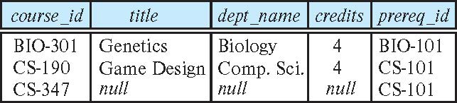
Right Outer Join
course natural right outer join prereq
Add to the prereq relation (on the right) the relevant info from course
In relational algebra:
course ⟖ prereq

Slide 17
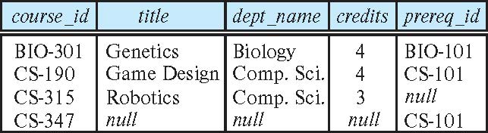
Full Outer Join
course natural full outer join prereq
In relational algebra:
course ⟗ prereq

Slide 18
Views
In some cases, it is not desirable for all users to see the entire logical model (that is, all the actual relations stored in the database.)
Consider a person who needs to know an instructor's name and department, but not the salary. This person should see a relation described, in SQL, by select ID, name, dept_name from instructor
A view provides a mechanism to hide certain data from the view of certain users.
Any relation that is not part of the conceptual model but is made visible to a user as a “virtual relation” is called a view.

Slide 19
View Definition
A view is defined using the create view statement which has the form
create view v as < query expression >
where <query expression> is any legal SQL expression. The view name is represented by v.
Once a view is defined, the view name can be used to refer to the virtual relation that the view generates.
View definition is not the same as creating a new relation by evaluating the query expression
Rather, a view definition causes the saving of an expression; the expression is substituted into queries using the view.

Slide 20
View Definition and Use
Create a view of instructors without their salary
create view faculty as select ID, name, dept_name from instructor
Find the names all instructors in the Biology department
select name from faculty where dept_name = 'Biology'
Create a view of department salary totals
create view departments_total_salary (dept_name, total_salary) as select dept_name, sum (salary) as total_salary from instructor group by dept_name;

Slide 21
Views Defined Using Other Views
One view may be used in the expression defining another view
A view relation v₁ is said to depend directly on a view relation v₂ if v₂ is used in the expression defining v₁
A view relation v₁ is said to depend on view relation v₂ if either v₁ depends directly to v₂ or there is a path of dependencies from v₁ to v₂
A view relation v is said to be recursive if it depends on itself.

Slide 22
Views Defined Using Other Views Example
create view physics_fall_2017 as select course.course_id, sec_id, building, room_number from course, section where course.course_id = section.course_id and course.dept_name = 'Physics' and section.semester = 'Fall' and section.year = '2017’;
create view physics_fall_2017_watson as select course_id, room_number from physics_fall_2017 where building= 'Watson';

Slide 23
View Expansion
Expand the view :
create view physics_fall_2017_watson as select course_id, room_number from physics_fall_2017 where building= 'Watson'
To:
create view physics_fall_2017_watson as
select course_id, room_number
from (select course.course_id, building, room_number
from course, section
where course.course_id = section.course_id
and course.dept_name = 'Physics'
and section.semester = 'Fall'
and section.year = '2017')
where building= 'Watson';

Slide 24
View Expansion (Cont.)
A way to define the meaning of views defined in terms of other views.
Let view v₁ be defined by an expression e₁ that may itself contain uses of view relations.
View expansion of an expression repeats the following replacement step:
repeat Find any view relation v_{i} in e₁ Replace the view relation v_{i} by the expression defining v_{i} until no more view relations are present in e₁
As long as the view definitions are not recursive, this loop will terminate

Slide 25
Update of a View
Add a new tuple to the faculty view which we defined earlier
insert into faculty
values ('30765', 'Green', 'Music');
This insertion must be represented by the insertion of the tuple into the instructor relation
Must have a value for salary
Two approaches
Reject the insert
Inset the tuple
('30765', 'Green', 'Music', null)
into the instructor relation

Slide 26
Some Updates Cannot be Translated Uniquely
create view instructor_info as select ID, name, building from instructor, department where instructor.dept_name = department.dept_name;
insert into instructor_info
values ('69987', 'White', 'Taylor');
Issues
Which department, if multiple departments in Taylor?
What if no department is in Taylor?

Slide 27
And Some Cannot be Done at All
create view history_instructors as select * from instructor where dept_name= 'History';
What happens if we insert
('25566', 'Brown', 'Biology', 100000)
into history_instructors?

Slide 28
View Updates in SQL
Most SQL implementations allow updates only on simple views
The from clause has only one database relation.
The select clause contains only attribute names of the relation, and does not have any expressions, aggregates, or distinct specification.
Any attribute not listed in the select clause can be set to null
The query does not have a group by or having clause.

Slide 29
Materialized Views
Certain database systems allow view relations to be physically stored.
Physical copy created when the view is defined.
Such views are called materialized view:
If relations used in the query are updated, the materialized view result becomes out of date
Need to maintain the view, by updating the view whenever the underlying relations are updated.

Slide 30
Transactions
A transaction consists of a sequence of query and/or update statements and is a “unit” of work
The SQL standard specifies that a transaction begins implicitly when an SQL statement is executed.
The transaction must end with one of the following statements:
Commit work. The updates performed by the transaction become permanent in the database.
Rollback work. All the updates performed by the SQL statements in the transaction are undone.
Atomic transaction
Either fully executed or rolled back as if it never occurred
Isolation from concurrent transactions

Slide 31
Integrity Constraints
Integrity constraints guard against accidental damage to the database, by ensuring that authorized changes to the database do not result in a loss of data consistency.
A checking account must have a balance greater than $10,000.00
A salary of a bank employee must be at least $11.00 an hour
A customer must have a (non-null) phone number

Slide 32
Constraints on a Single Relation
not null
primary key
unique
check (P), where P is a predicate

Slide 33
Not Null Constraints
An attribute tagged with not null cannot have a null value
Declare name and budget to be not null
name varchar(20) not null budget numeric(12,2) not null

Slide 34
Unique Constraints
unique ( A₁, A₂, …, A_{m})
The unique specification states that the attributes A₁, A₂, …, A_{m} form a candidate key.
Candidate keys are permitted to be null (in contrast to primary keys).

Slide 35
The check clause
The check (P) clause specifies a predicate P that must be satisfied by every tuple in a relation.
Example: ensure that the value of semester is one of {fall, winter, spring or summer}
create table section
(course_id varchar (8),
sec_id varchar (8),
semester varchar (6),
year numeric (4,0),
building varchar (15),
room_number varchar (7),
time slot id varchar (4),
primary key (course_id, sec_id, semester, year),
check (semester in ('Fall', 'Winter', 'Spring', 'Summer')))

Slide 36
Referential Integrity
Ensures that a value that appears in one relation for a given set of attributes also appears for a certain set of attributes in another relation.
Example: If “Biology” is a department name appearing in one of the tuples in the instructor relation, then there exists a tuple in the department relation for “Biology”.
Let A be a set of attributes. Let R and S be two relations that contain attributes A and where A is the primary key of S. A is said to be a foreign key of R if for any values of A appearing in R these values also appear in S.
S is the referencing relation
R is the referenced relation

Slide 37
Referential Integrity in SQL
Foreign keys can be specified as part of the SQL create table statement
foreign key (dept_name) references department
By default, a foreign key references the primary-key attributes of the referenced table.
SQL allows a list of attributes of the referenced relation to be specified explicitly.
foreign key (dept_name) references department (dept_name)

Slide 38
Cascading Actions in Referential Integrity
When a referential-integrity constraint is violated, the normal procedure is to reject the action that caused the violation.
The transaction performing the update action is rolled back
For foreign keys, in the case of a delete or update, instead of rejecting the action, the system can take steps to change the tuple in the referencing relation to restore the constraint.
In the declaration of a foreign key, we can use:
on delete cascade
on update cascade,
For delete, If a delete of a tuple results in a referential-integrity constraint being violated, the system does not reject the delete. Instead, the delete cascades to the referencing relation, deleting the appropriate tuples
Similarly for updates

Slide 39
Cascading Actions Example
Consider the declaration of course
create table course ( (… dept_name varchar(20), foreign key (dept_name) references department on delete cascade on update cascade, . . .)
If we delete department Physics, then we also delete all courses offered in the Physics department
Instead of cascade we can use :
set null,
set default

Slide 40
Integrity Constraint Violation During Transactions
Consider:
create table person ( ID char(10), name char(40), mother char(10), father char(10), primary key ID, foreign key father references person, foreign key mother references person)
How to insert a tuple without causing constraint violation?
Insert father and mother of a person before inserting person
OR, set father and mother to null initially, update after inserting all persons (not possible if father and mother attributes declared to be not null)
OR defer constraint checking

Slide 41
Complex Check Conditions
The predicate in the check clause can be an arbitrary predicate that can include a subquery.
check (time_slot_id in (select time_slot_id from time_slot))
The check condition states that the time_slot_id in each tuple in the section relation is actually the identifier of a time slot in the time_slot relation.
The condition has to be checked not only when a tuple is inserted or modified in section , but also when the relation time_slot changes

Slide 42
Assertions
An assertion is a predicate expressing a condition that we wish the database always to satisfy.
The following constraints, can be expressed using assertions:
For each tuple in the student relation, the value of the attribute tot_cred must equal the sum of credits of courses that the student has completed successfully.
An instructor cannot teach in two different classrooms in a semester in the same time slot
An assertion in SQL takes the form:
create assertion <assertion-name> check (<predicate>);

Slide 43
Built-in Data Types in SQL
date: Dates, containing a (4 digit) year, month and day
Example: date '2005-7-27'
time: Time of day, in hours, minutes and seconds.
Example: time '09:00:30'
Example: time '09:00:30.75'
timestamp: date plus time of day
Example: timestamp '2005-7-27 09:00:30.75'
interval: period of time
Example: interval '1' day
Subtracting a date/time/timestamp value from another gives an interval value
Interval values can be added to date/time/timestamp values

Slide 44
User-Defined Types
create type construct in SQL creates user-defined type
create type Dollars as numeric (12,2) final
Example:
create table department (dept_name varchar (20), building varchar (15), budget Dollars);

Slide 45
Domains
create domain construct in SQL-92 creates user-defined domain types
create domain person_name char(20) not null
Types and domains are similar. Domains can have constraints, such as not null, specified on them.
Example:
create domain degree_level varchar(10) constraint degree_level_test check (value in ('Bachelors', 'Masters', 'Doctorate'));

Slide 46
Large-Object Types
Large objects (photos, videos, CAD files, etc.) are stored as a large object:
blob: binary large object -- object is a large collection of uninterpreted binary data (whose interpretation is left to an application outside of the database system).
Photo of a student
Video of a lecture
clob: character large object -- object is a large collection of character data
Essay of a student
Large objects are usually not stored in the tables
When a query returns a large object, a pointer is returned rather than the large object itself.
What can you do with large objects?

Slide 47
Index Creation
Many queries reference only a small proportion of the records in a table.
It is inefficient for the system to read every record to find a record with particular value
An index on an attribute of a relation is a data structure that allows the database system to find those tuples in the relation that have a specified value for that attribute efficiently, without scanning through all the tuples of the relation.
We create an index with the create index command
create index <name> on <relation-name> (attribute);

Slide 48
Index Creation Example
create table student (ID varchar (5), name varchar (20) not null, dept_name varchar (20), tot_cred numeric (3,0) default 0, primary key (ID))
create index studentID_index on student(ID)
The query:
select * from student where ID = '12345'
can be executed by using the index to find the required record, without looking at all records of student

Slide 49
Authorization
We may assign a user several forms of authorizations on parts of the database.
Read - allows reading, but not modification of data.
Insert - allows insertion of new data, but not modification of existing data.
Update - allows modification, but not deletion of data.
Delete - allows deletion of data.
Each of these types of authorizations is called a privilege.
We may authorize the user all, none, or a combination of these types of privileges on specified parts of a database, such as a relation or a view.

Slide 50
Authorization (Cont.)
Forms of authorization to modify the database schema
Index - allows creation and deletion of indices.
Resources - allows creation of new relations.
Alteration - allows addition or deletion of attributes in a relation.
Drop - allows deletion of relations.

Slide 51
Authorization Specification in SQL
The grant statement is used to confer authorization
grant <privilege list> on <relation or view > to <user list>
<user list> is:
a user-id
public, which allows all valid users the privilege granted
A role (more on this later)
<privilege > is:
select, insert, update, delete, all
Example:
grant select on department to Amit, Satosh
Granting a privilege on a view does not imply granting any privileges on the underlying relations.
The grantor of the privilege must already hold the privilege on the specified item (or be the database administrator).

Slide 52
Privileges in SQL
select allows read access to relation, or the ability to query using the view
Example: To grant users U₁, U₂, and U₃ the select authorization on the instructor relation:
grant select on instructor to U₁, U₂, U₃
insert: the ability to insert tuples
update: the ability to update using the SQL update statement
delete: the ability to delete tuples.
all privileges: used as a short form for all the allowable privileges

Slide 53
Revoking Authorization in SQL
The revoke statement is used to revoke authorization.
revoke <privilege list> on <relation or view> from <user list>
Example:
revoke select on student from U₁, U₂, U₃
<privilege-list> may be all to revoke all privileges the revokee may hold.
If <revokee-list> includes public, all users lose the privilege except those granted it explicitly.
If the same privilege was granted twice to the same user by different grantees, the user may retain the privilege after the revocation.
How do you implement this?
All privileges that depend on the privilege being revoked are also revoked.

Slide 54
Roles
A role is a way to distinguish among various users as far as what these users can access/update in the database.
To create a role, we use:
create a role <name>
Example:
create role teacher
Once a role is created, we can assign “users” to the role using:
grant <role> to <users>
Example:
create role teacher;
grant teacher to Amit;

Slide 55
Roles (Cont.)
Privileges can be granted to roles:
grant select on takes to teacher
Roles can be granted to users, as well as to other roles
create role teaching_assistant
grant teaching_assistant to teacher;
Teacher inherits all privileges of teaching_assistant
Chain of roles
create role dean;
grant teacher to dean;
grant dean to Satoshi;

Slide 56
Authorization on Views
create view geo_instructor as (select * from instructor where dept_name = 'Geology');
grant select on geo_instructor to geo_staff
Suppose that a geo_staff member issues
select * from geo_instructor;
What if
geo_staff does not have permissions on instructor?
Creator of view did not have some permissions on instructor?

Slide 57
Other Authorization Features
Transfer of privileges
grant select on department to Amit with grant option;
revoke select on department from Amit, Satoshi cascade;
revoke select on department from Amit, Satoshi restrict;
And more!

Slide 58
Food for Thought
Are there queries that cannot be expressed in SQL?
Notes:
9

Slide 59
End of Chapter 4

Slide 60
Other Authorization Features
references is the privilege to create foreign key
grant reference (dept_name) on department to Mariano;
Why is this required?
Transfer of privileges
grant select on department to Amit with grant option;
revoke select on department from Amit, Satoshi cascade;
revoke select on department from Amit, Satoshi restrict;
And more!

Slide 61
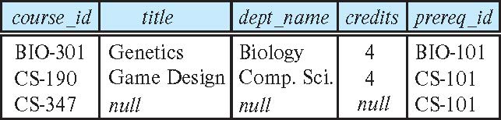
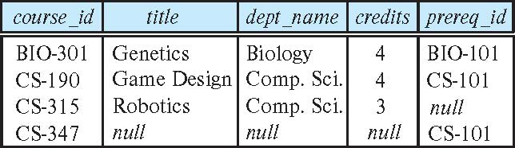
Joined Relations – Examples
course natural right outer join prereq
course full outer join prereq using (course_id)

Slide 62
Natural Join in SQL
Natural join matches tuples with the same values for all common attributes and retains only one copy of each common column.
List the names of instructors along with the course ID of the courses that they taught
select name, course_id from students, takes where student.ID = takes.ID;
Same query in SQL with “natural join” construct
select name, course_id from student natural join takes;

Slide 63
Natural Join Versus Cartesian Product
List the names of instructors along with the course ID of the courses that they taught
select name, course_id from students, takes where student.ID = takes.ID;
Same query in SQL with “natural join” construct
select name, course_id from student natural join takes;
Are the above two queries giving us the same result?

Slide 64
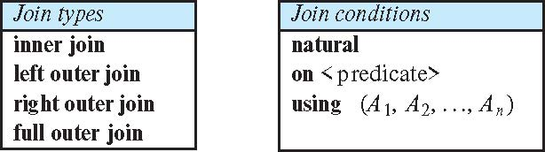
Joined Types and Conditions
Join operations take two relations and return as a result another relation.
These additional operations are typically used as subquery expressions in the from clause
Join type – defines how tuples are treated in each relation that do not match any tuple in the other relation (based on the join condition).
Join condition – defines which tuples in the two relations match.

Slide 65
Joined Types and Conditions
Join type – defines how tuples are treated in each relation that do not match any tuple in the other relation (based on the join condition).
Join condition – defines which tuples in the two relations match.

Slide 66
Joined Relations – Examples
course natural right outer join prereq
course full outer join prereq using (course_id)

Slide 67
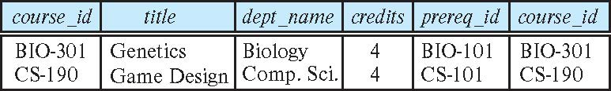
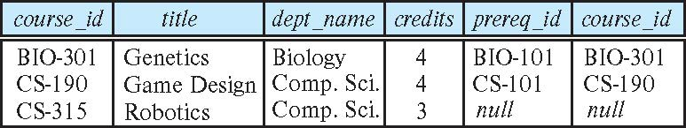
Joined Relations – Examples
course inner join prereq on course.course_id = prereq.course_id
What is the difference between the above, and a natural join?
course left outer join prereq on course.course_id = prereq.course_id

